Slide 1
Multicore Locks: The Case Is Not Closed Yet
Hugo Guiroux, Renaud Lachaize, Vivien Qu´ema
Keon-Pyo, Lee
Dependable software laboratory

Slide 2
Summary
In multicore system
There is currently no broad study of the behavior of optimized lock algorithms on realistic applications
For choose locks fit well,
So this paper perform a performance study of 27 state-of- the art mutex lock algorithms on 35 applications
And attempts to fill that gap.

Slide 3
Variety of lock algorithms
Flat approaches
correspond to simple algorithms
Queue-based approach
locks based on a waiting queue in order to improve fairness as well as the memory traffic
Hierarchical approach
specifically aimed at providing scalable performance on large-scale NUMA machines
Load-control approach
algorithms that aim at limiting the number of threads that concurrently attempt to acquire a lock
Delegation-based approach
algorithms in which it is necessary for a thread to delegate the execution of a critical section to another thread

Slide 4
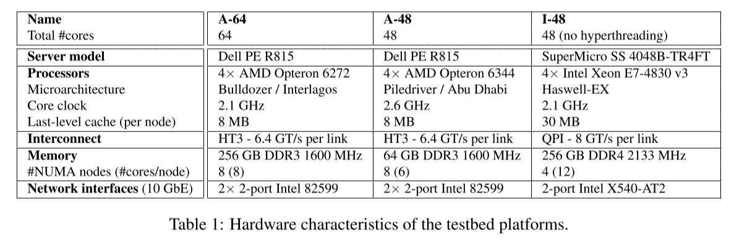
Experimental setup

Slide 5
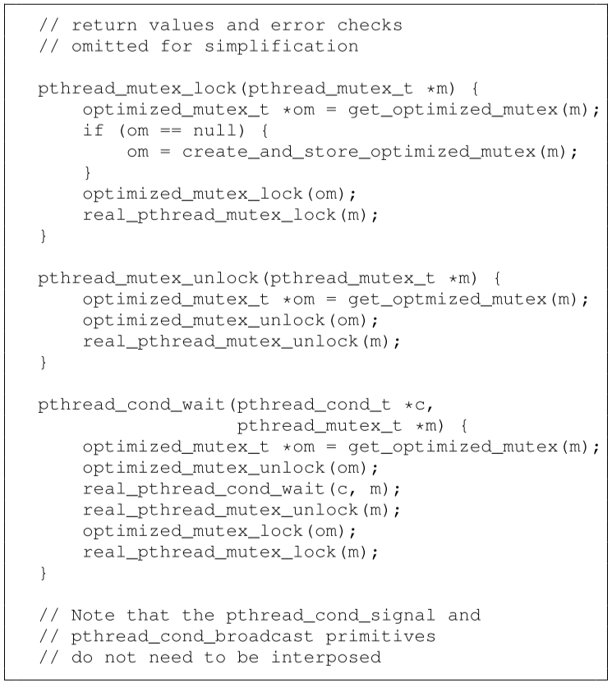
The LiTL lock interposition library
An interposition library allowing transparently replacing the lock algorithm used for Pthread mutexes.
To maintain a mapping structure between an instance of the standard Pthread lock and an instance of the chosen optimized lock type

Slide 6
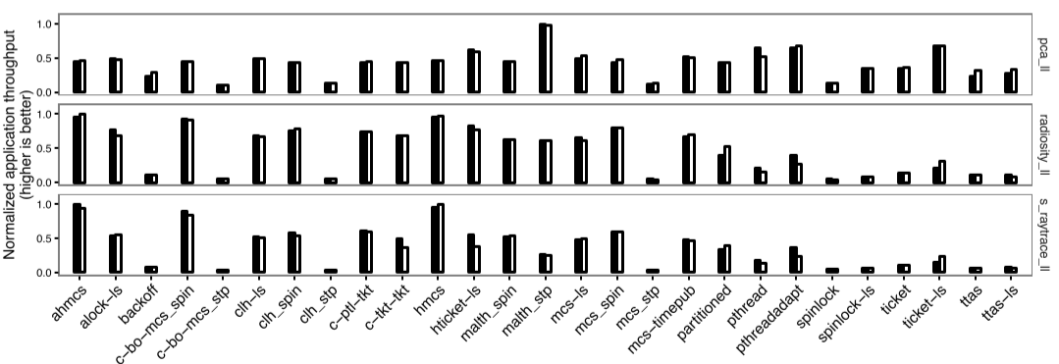
Experimental validation(LiTL)
compare the performance (throughput) of each lock on a set of applications running in two distinct configurations (for experiment with LiTL instead of manual implementation)
manually modified applications
unmodified applications using in-terposition with LiTL
RESULT
the achieved performance is close and
the general trends for the different locks remain stable

Slide 7

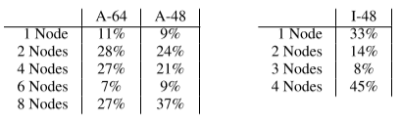
Performance study of lock algorithms
Use LiTL to compare the behavior of the different lock algorithms on different workloads and at different levels of contention.
Selection of lock-sensitive applications
application is lock-sensitive if the relative standard deviation for the performance of the different locks at max nodes is higher than 10%
Selection of the number of nodes
For each (application, lock) pair, the corresponding cell indicates the performance gain of the optimized configuration with respect to the max-node configuration.
the main questions investigated in the study
comparing locks at a fixed number of nodes
comparing locks at their optimized configurations

Slide 8
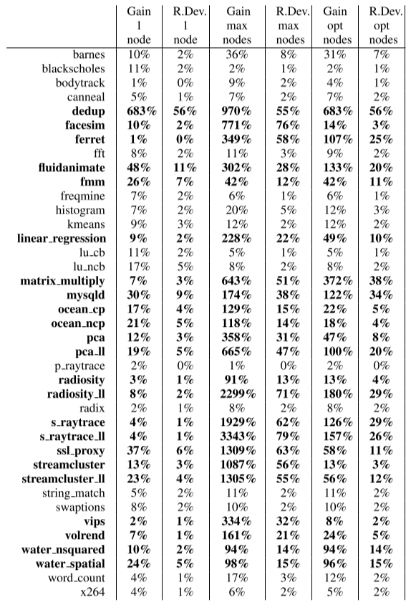
Q1. How much do locks impact applications?
At 1 node, the impact of locks on lock-sensitive applications is moderate.
At max nodes, the impact of locks is very high for all lock-sensitive applications.
At the optimized number of nodes, the impact of locks is high, but noticeably lower than at max nodes.

Slide 9
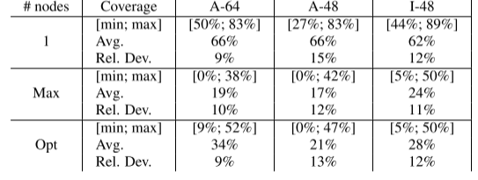
Q2. Are some locks always among the best?
No lock is among the best for more than 89% of the applications at 1 node and for more than 52% of the applications both at max nodes and at the optimal number of nodes.

Slide 10
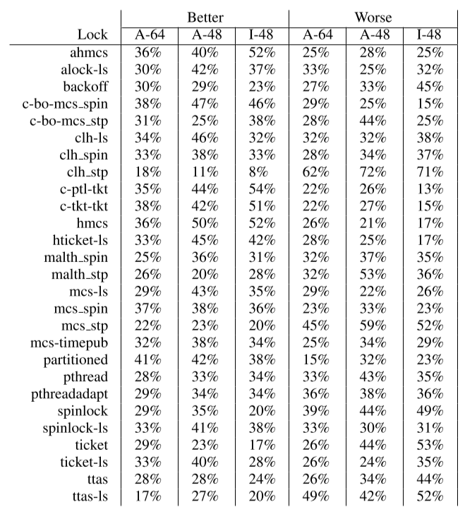
Q3. Is there a clear hierarchy between locks?
there is no clear global performance hierarchy between locks.

Slide 11
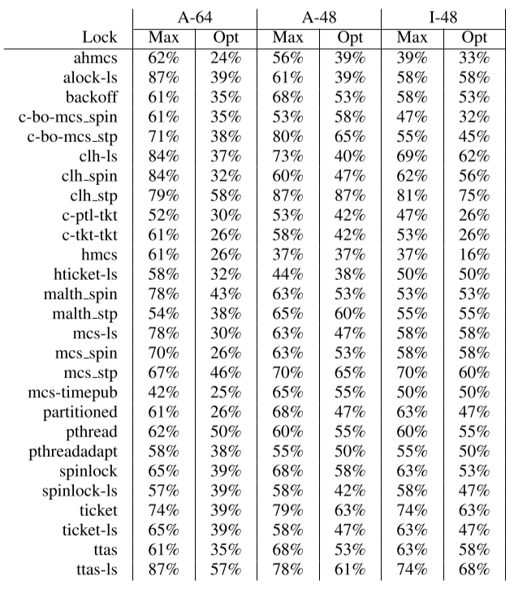
Q4. Are all locks potentially harmful?
both at max nodes and at the optimal number of nodes, all locks are potentially harmful, yielding sub-optimal performance for a significant number of applications

Slide 12
Additional observations
For all applications, the lock performance hierarchy changes significantly according to the chosen number of nodes.
The lock performance hierarchy changes significantly according to the chosen machine
Pthread locks perform well for a significant share of the studied applications
All the conclusions presented in the paper still hold with per-node thread pinning.

Slide 13
Conclusion
presented a broad study of 27 locks algorithms with 35 applications on Linux/x86.
Implemented LiTL, an interposition library allowing the transparent replacement of lock algorithms used for Pthread mutex locks.
at its optimized contention level, no single lock dominates for more than 52% of the lock-sensitive applications.
any of the locks is harmful for at least several applications.
for a given application, the best lock varies according to both the number of contending cores and the machine that executes the application.

